Slide 1

Course Project (Optimisation )
Pattern Search Optimization
By
Janak Patel (20302001)
Darshak Ginoya (20302027)
B Shibani (20302050)
16-04-2021
IIT Bombay

Slide 2
Motivation
Optimisation of a multidimensional, implicitly specified, non smooth cost function.
Accurate approximation of functions defined on the solution of complex system of equations including implicit equations, ordinary differential equations, and partial differential equations often takes many hours.
There’s no straightforward way of approximating gradients.
Hence, standard pattern search algorithms can only be used heuristically in this context.
There are mainly two types of methods for optimization.
Derivative based method
Direct search method
Pattern search optimization is a Direct search method.
16-04-2021
Pattern Search Optimization

Slide 3
Idea of the Algorithm
Pattern search is a direct search routine for minimizing a function f, resulting the sequence of iterates {xk}. This method satisfies
$\lim_{k→∞}{∥Δf(x_{k})∥}_{∞}$= 0
without ever computing or explicitly approximating derivatives.
At each iteration, the function is evaluated at trial points on a discrete mesh containing the current iterate in search of one yielding any decrease in the objective function value.
We construction the mesh, which is then explored according to some rule, and if no decrease in cost is obtained on mesh points around the current iterate, then the mesh is refined and the process is repeated.
Types of pattern search algorithm
Hooke and Jeeves
the coordinate search algorithm
the multidirectional search algorithm of Dennis and Torczon.
Powell’s Conjugate direction method
16-04-2021
Pattern Search Optimization

Slide 4
Hooke Jeeves Method
This method keeps track of the direction of travel as the process moves from point to point, instead of starting over from scratch at each new point.
A combination of exploratory and pattern moves
Exploratory – find the best point in the vicinity of the current point
Pattern – Jump in the direction of change, if better then continue, else reduce size of exploratory move and continue
16-04-2021
Pattern Search Optimization

Slide 5
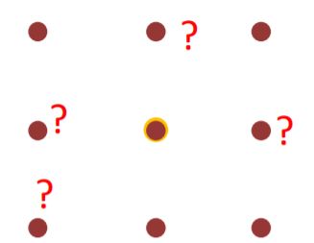
Exploratory Move
Step 1: Choose initial point $x^{0}$, mess size factor Δi, step reduction parameter α
$i=1,2….,N$ [N = size($x^{0}$)]
Step 2: $f=f\left(x^{0}\right),f^{+}=f\left(x_{i}^{0}+∆_{i}\right),$ $f^{−}=f\left(x_{i}^{0}−∆_{i}\right)$
Step 3: $f_{min}=\min\left(f,f^{+},f^{−}\right);$ set $x^{1}$corresponding to $f_{min}$
Step 4: If i = N then go to step 5 else i = i+1 & go to step 2.
Step 5: If $x^{1}=x^{0}$ then $∆_{i}=\frac{∆_{i}}{α}$ where $α>1$
else go to pattern move else
Figure: Mess for exploratory move
16-04-2021
Pattern Search Optimization

Slide 6
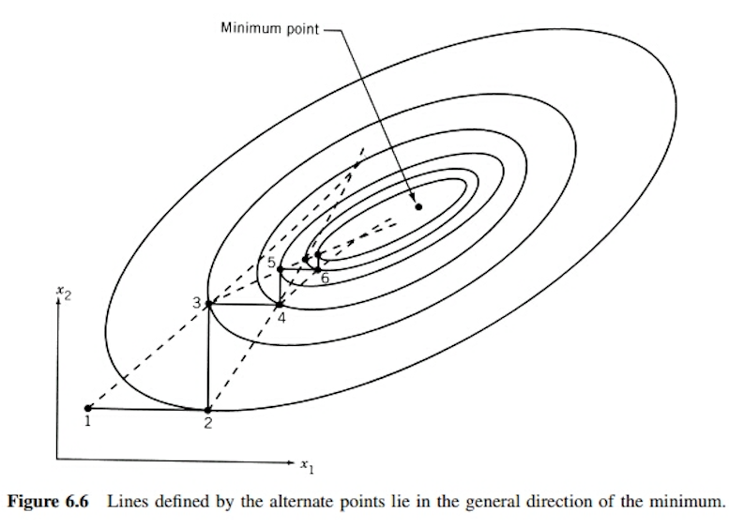
Pattern Move
Step 1: Pattern direction s= $x^{1}−x^{0}$
Step 2: $x^{2}=x^{1}$+s
Step 3: $x^{0}=x^{1}repeatexploratorymoveuntil$ $\left|Δ\right|<ϵ$
where $ϵ$ is tolerance
We move in the direction (s) till we get decrease in the objective function value. [s = x_new - x_old]
So step 2 is extended as follows:
For k=1:max iteration
If (${f(x}^{2}$) < ${f(x}^{1})$)
$x^{2}=x^{1}$+s
$x^{1}$ =$x^{2}$
else $x^{1}=x^{1}$
break
Modification
Figure: Lines defined by the alternate points lie in the general direction of the minimum
16-04-2021
Pattern Search Optimization

Slide 7
Validity of Modification
Tested Functions -
$f1\left(x_{1},x_{2}\right)={(x_{1}−3)}^{2}+$ ${(x_{2}+1)}^{2}$
$f2\left(x_{1},x_{2}\right)={(x_{1}+x_{2})}^{2}+$ ${(x_{2})}^{2}+{(sin({x_{1}+2))}}^{2}$ $+$10
$f3\left(x_{1},x_{2}\right)={({x_{1}}^{2}+x_{2}−11)}^{2}+$ ${({x_{2}}^{2}+x_{1}−7)}^{2}$
$f4\left(x_{1},x_{2}\right)=100{(x_{1}−{x_{2}}^{2})}^{2}$ $+{({1−x}_{1})}^{2}$
$$f5(x_{1},x_{2})=100(2+x_{2}−x_{1}^{2})^{2}+(1−x_{1})^{2}$$
$$f6(x_{1},x_{2})=100(2+x_{2}^{2}−x_{1}^{3})^{2}+(5+x_{2}−x_{1})^{2}$$
16-04-2021
Pattern Search Optimization

Slide 8
Validity of Modification
Number of iterations of different function for HV and MHV
Function | Hooke Jeeves | Modified Hooke Jeeves
f1 | 22 | 22
f2 | 30 | 30
f3 | 22 | 22
f4 | 3587 | 3156
f5 | 42641 | 14818
f6 | 10271 | 7634
For simple problem HJ and MHJ both give same performances.
For complex problem where number of iterations is high, MHJ converges faster than HJ.
16-04-2021
Pattern Search Optimization

Slide 9
Comparison
The comparison of different method with Hookes & Jeeves method is mentioned below in terms of iterations and time:
Here, Function is Rosen brock with initial condition: [1.5;1.5]
Method Name | Iterations | Time (second)
Hookes & Jeeves | 3587 | 1.5474
Modified Hookes & Jeeves | 3156 | 1.3777
Steepest decent | 8143 | 12.26
Newton’s full step | 6 | 0.9569
16-04-2021
Pattern Search Optimization

Slide 10
Results
Modified-HJ algorithm implementation on Rosen-brock function: $f=100(x_{1}−x_{2}^{2})^{2}+(1−x_{1})^{2}$
x vector vs. Iteration number
f vs. Iteration number
16-04-2021
Pattern Search Optimization

Slide 11
Results
Performance comparison of HJ and MHJ
x vector vs. Iteration number for MHJ and HJ algorithm
f vs. Iteration number for MHJ and HJ algorithm
16-04-2021
Pattern Search Optimization

Slide 12
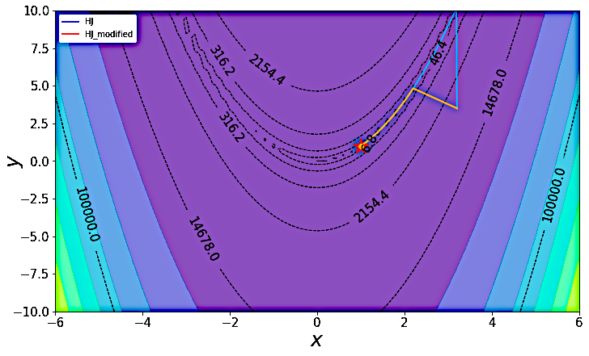
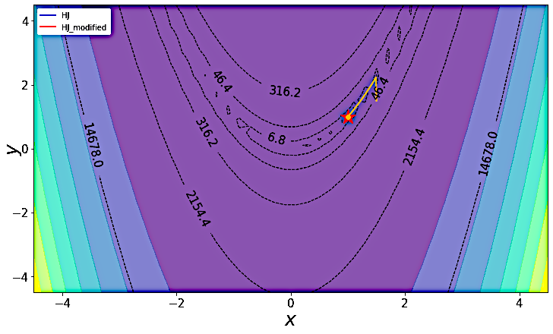
Results
Contour plot for Rosen-brock function when HJ and MHJ
implemented with initial guess: (3.2,3.5)
Contour plot for Rosen-brock function when HJ and MHJ
implemented with initial guess: (1.5,1.5)
16-04-2021
Pattern Search Optimization

Slide 13
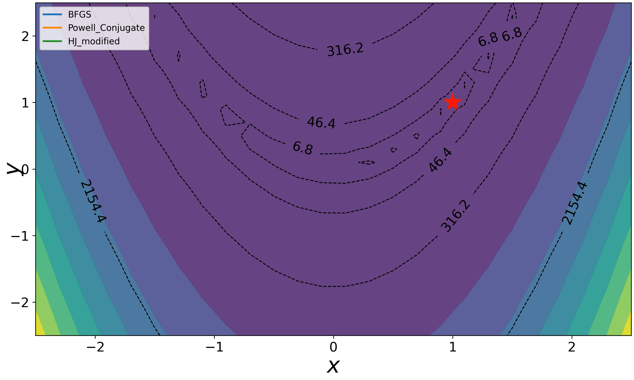
Results
Animation of Contour plot for Rosen-brock function when HJ, MHJ, BFGS and Powell Conjugate implemented with initial guess: (1.5,1.5)
16-04-2021
Pattern Search Optimization

Slide 14
Engineering Applications
Mechanical design engineering -
Metal cutting process - 3 M’s (manpower, materials and machines)
Development of a magnetic system mathematical model -
Minimum expenditure for preparation of initial data, acceptable
counting time and automatic convergence at a large interval of input
parameter variation.
Creation of design methods for direct current electric devices, in particular, electromagnetic separators.
Enables highly accurate calculation of nonlinear equation systems describing complex magnetic circuits.
16-04-2021
Pattern Search Optimization

Slide 15
Conclusion
The algorithm described uses direct search method.
No derivative calculations involved so computation will be less.
Acceleration is accomplished robustly by carrying out feasible number of pattern moves.
In three of the six function examples, improved Hooke-Jeeves algorithm yields lesser number of iterations compared to the HJ algorithm.
For simple problems both the algorithms yield same results.
MHJ algorithm outperforms the steepest descent method too as the later takes more than 8000 iterations to converge.
16-04-2021
Pattern Search Optimization

Slide 16
Additional Work
HJ and MHJ algorithms work satisfactorily to find global optimum over test function for single objective optimization problems. Benchmark test function used were Ackley function and Eggholder function.
To compare different algorithms over a given test function toolbox can be used like EvoloPy which provides nature-inspired metaheuristic optimizer.
Contour plot for ackley function when HJ, MHJ, BFGS and Powell Conjugate implemented with initial guess: (3.2, 3.5)
16-04-2021
Pattern Search Optimization

Slide 17
References
Nicholas V. Findler, Cher LO and Ron LO, Pattern search for optimisation, Mathematics and Computers in Simulation, vol. 29, 41-5, 1987.
Charles Audet, J.E.Dennis,JR., Pattern search algorithms for mixed variable programming, Society for industrial and applied mathematics, vol. 11, 573-594, 2000.
Michael Wetter and Jonathan Wright, Comparison of a generalised pattern search and genetic algorithm optimisation method, Eighth International IBPSA Conference, 2003.
Audet, Charles, and J. E. Dennis, Jr., Pattern Search Algorithms for Mixed Variable Programming, SIAM Journal on Optimization , vol.11, 573–594, 2000.
Mr. G.S. Kirgat, Prof.A.N. Surade, Applicability of Hooke’s-jeeves direct search solution method to metal cutting operation, Internatinal journal of innovation in engineering research and technology, vol.2, 2394-3696, 2015.
Mykhaylo zagienyak, Oksana Usatiuk, Volodymyr Usatyuk, The use of the hook-jeeves method for the calculation of complex nonlinear equivalent magnetic circuits, Journal of energy technology, vol. 10, 11-18, 2017.
16-04-2021
Pattern Search Optimization

Slide 18
Thank you…
Any Questions ?

